Slide 1
IMAGE MORPHING
Submitted to -
Dr. Anukriti Bansal
Submitted by –
Vatsal Agarwal(17ucs175)
Yash Agarwal(17ucc069)

Slide 2
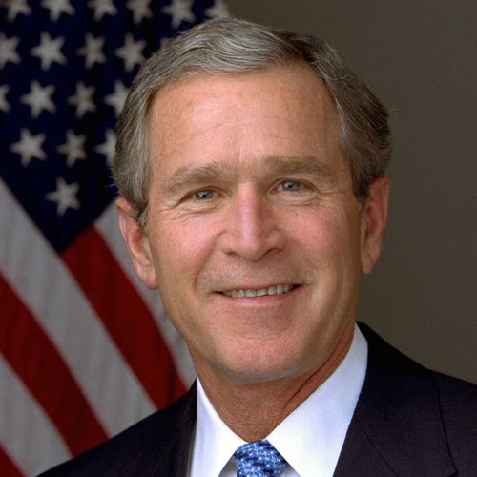
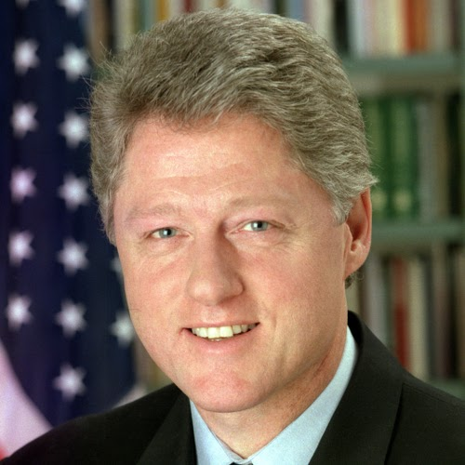
Objective of project
Morph a image with intermediate frames into targeted image.

Slide 3
Process
Selecting feature points in image.
Triangulate the image using feature points.
Warp the image.

Slide 4
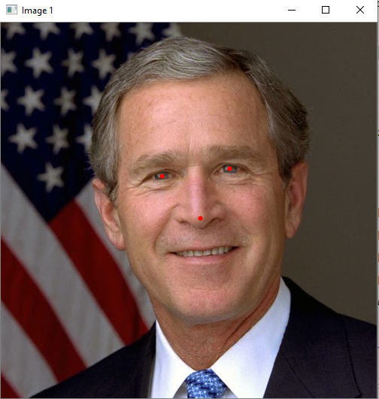
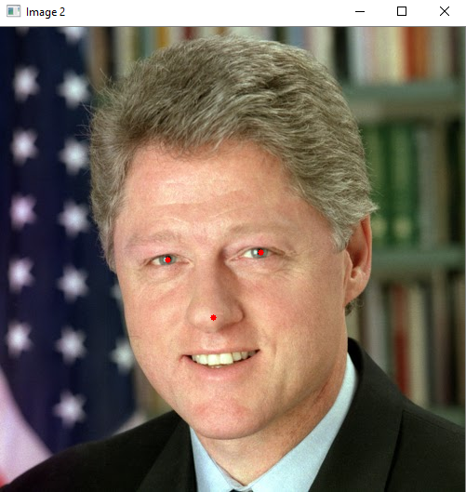
Selecting Feature points
We have done selection of feature points with the user giving input from the mouse.

Slide 5
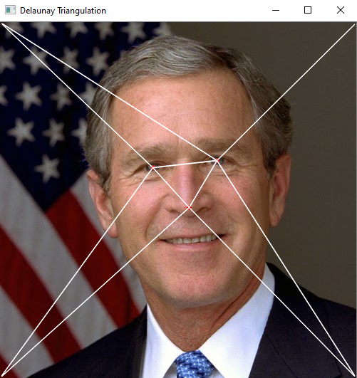
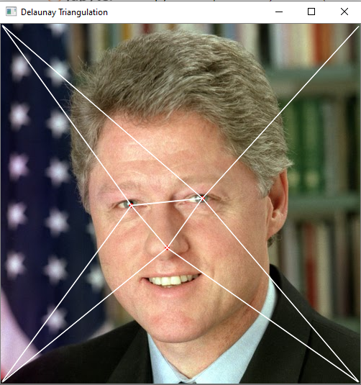
Triangulating Image
Perform Delaunay triangulation to obtain the section(trinangles) of the images for further processing by using this sections.

Slide 6
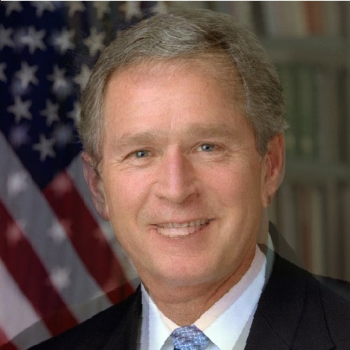
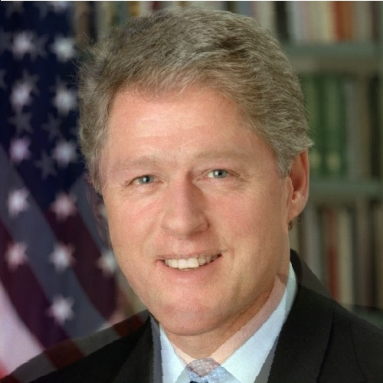
Warping Images
Using triangles from last step obtain morphed images (Intermediate Images for our goal)

Slide 7
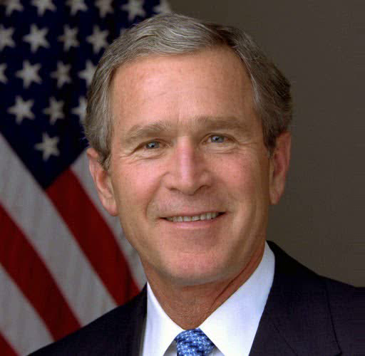
Slide Show of Intermediate frames

Slide 8
Thank You !!!

